Slide 1
Math for Data Analysis
Titanic (Data Analysis)

Slide 2
Titanic - History
The sinking of the RMS Titanic is one of the most infamous shipwrecks in history.
On April 15, 1912, during her maiden voyage, the Titanic sank after colliding with an iceberg, killing 1502 out of 2224 passengers and crew
One of the reasons that the shipwreck led to such loss of life was that there were not enough lifeboats for the passengers and crew.

Slide 3
Titanic – Passenger Survival Analysis
Theme
Descriptive Statistical Analysis of survival on Titanic
Dataset Link
https://vincentarelbundock.github.io/Rdatasets/datasets.html
Data File
TitanicSurvival.csv

Slide 4
Questions
Relationship between survival and gender.?
Maximum survivals from different age groups.?
Which region has the highest death percentage.?
Relation between maximum survivals and embarked ports.?

Slide 5
Data Description
Attribute | Attribute Type | Description
Survival | Binary | 0 = No, 1 = Yes
Pclass | Categorical | 1 = 1st, 2 = 2nd, 3 = 3rd (passenger class)
Sex | Binary | male / female
Age | Numerical | age in years
Sibsp | Categorical | # of siblings / spouses aboard the Titanic
Parch | Categorical | # of parents / children aboard the Titanic
Ticket | unique number | Ticket number
Fare | Numerical | Passenger fare
Cabin | Numerical | Cabin number
Embarked | Categorical | Port of Embarkation C = Cherbourg, Q = Queenstown, S = Southampton
Boat | Categorical | rescue boat number
Body | not specified | whether body found or not
home.dest | nominal | home destination

Slide 6
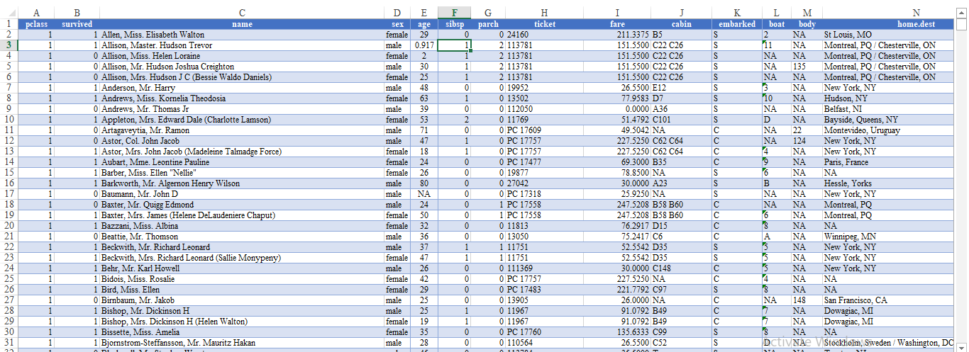
Dataset Example (1309 observations)

Slide 7
Data Cleaning
Derived missing values for all records.
Found and discarded variables such as body, boat, cabin and home.dest were having more than 40% missing values.
Removed records with missing age.
Created 4 different categories based on age for better visualization.
Replaced missing values for variable embarked and fare based on probability.
After final data cleansing we are left with 1046 records and 10 variables for analysis.

Slide 8
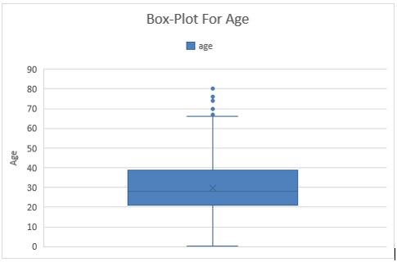
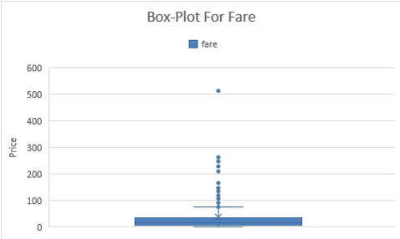
Outliers Detection (fare and age)

Slide 9
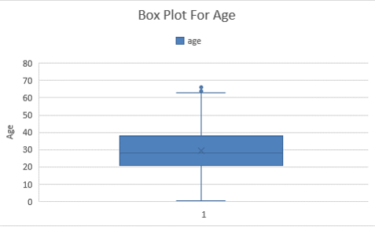
Descriptive Statistics
Age |  | Fare
Mean | 29.55026 | 27.84009
Standard Error | 0.433358 | 0.929454
Median | 28 | 14.5
Mode | 24 | 13
Standard Deviation | 13.96194 | 29.47996
Sample Variance | 194.9356 | 869.0679
Kurtosis | -0.0931 | 4.540377
Skewness | 0.294238 | 2.118205
Range | 66.8333 | 153.4625
Minimum | 0.1667 | 0
Maximum | 67 | 153.4625
Sum | 30673.17 | 28007.13
Count | 1038 | 1006

Slide 10
Graphical Visualization

Slide 11
Graphical Visualization

Slide 12
THANK YOU..
Group Members:
Sushil Sharma
Jigar Patel
Jael Beryl Ruth
Pratik Patel
Nirmal Patel

